Slide 1
Outline:
Introduction
Solvability
Manipulator subspace when n<6
Algebraic vs. Geometric
Example: Kinematics of PUMA Robot

Slide 2
Introduction:
Direct kinematics:
Given the joint angles ➔ calculate the position and orientation of the tool {T} relative to the station {S}
Inverse kinematics:
Given the desired position and orientation of the tool {T} relative to the station {S}, how to calculate the set of joint angles that give the desired result?
Find {W} from {T};
Find {B} from {S};
Solve for joint angles

Slide 3
Solvability:
Nonlinear problem: solve to find the values of
Linear and nonlinear problems?
Ex.: Puma manipulator
12 values ➔ find
➔12 equations and 6 unknowns,
rotation part (r₁₁ … r₃₃), only 3 independent

Slide 4
Solvability:
Nonlinear problem: solve to find the values of
Linear and nonlinear problems?
Ex.: Puma manipulator
12 values ➔ find
➔12 equations and 6 unknowns,
rotation part (r₁₁ … r₃₃), only 3 independent

Slide 5
Solvability:
➔ 3 independent equations for the orientation and 3 independent equations for the position
Nonlinear equations that are difficult to solve.
Note that these were for simple links α = 0, 90, -90, … and many (d & a) = 0.
General case (α, d, & a) have other nonzero values
More complex case.
We must concern on
Existence of solution?
Multiple solutions?
Method of solution?

Slide 6
Solvability: (Existence of solution)
Existence of solution
Existence or nonexistence of a solution defines the workspace of the manipulator.
Workspace (W.S.): (Figure)
The volume of the space that the E.E. of the robot can reach.
A solution to exist ➔ the desired position & orientation (goal) must lie in the W.S.
Two types of workspaces:
Dextrous W.S.: volume of the W.S. in which the E.E. can reach with all the orientations.
Reachable W.S.: volume of the W.S. in which the E.E. can reach in at least one orientation.
➔ Dextrous W.S. is a subset of the reachable W.S.

Slide 7
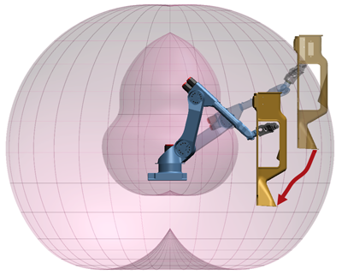
Solvability: (Existence of solution)
Return

Slide 8
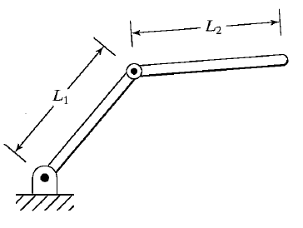
Solvability: (Existence of solution)
Example: if l₁ = l₂ determine the dextrous and reachable W.S.

Slide 9
Solvability: (Existence of solution)
Example: if
l₁ = (l₂/2)
determine the dextrous and
reachable W.S.

Slide 10
Solvability: (Existence of solution)
Factors that affect the W.S. of a robot:
Limitations on joint angles
Generally: min < θ_{i} < max. Most of the robots have limitations on their joint angles.
➔ The W.S. is reduced; this may affect the attained positions or the number of orientations for the attained position.
Ex.: for the previous sketch 0 ≤ θ_{i} ≤ 180 sketch the W.S.
➔ The same positions can be reached, however in only one orientation.
Limitations on the number of DoF:
A 3D-space goal is not attainable by a manipulator of DoF < 6.
For the manipulator of the previous example can not attain a position of nonzero z-value.

Slide 11
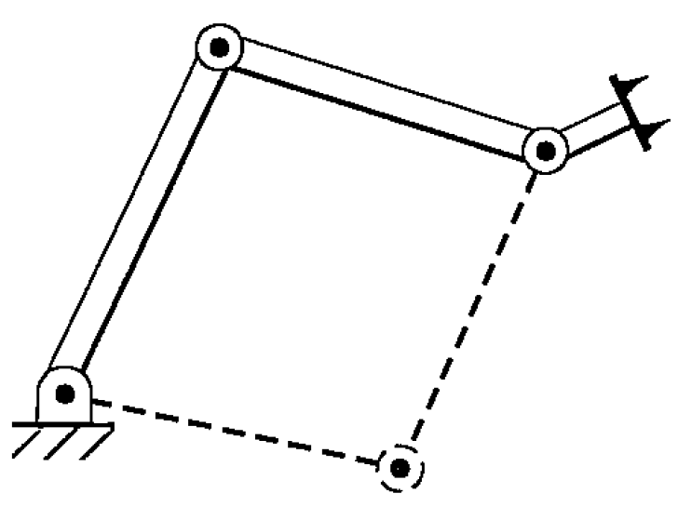
Solvability: (Multiple Solutions)
The manipulator can reach the goal with different configurations.
Ex. The planar 3DoF manipulator shown can reach any goal in the dextrous W.S. in more than one way.
➔ (Problem) the system should be able
to calculate all and choose one.
A good choice can be based on
minimizing the amount that each joint
is required to move. Which is almost
the same as choosing the solution
“closest” to the current configuration.
Must be investigated. (energy, path,…)

Slide 12
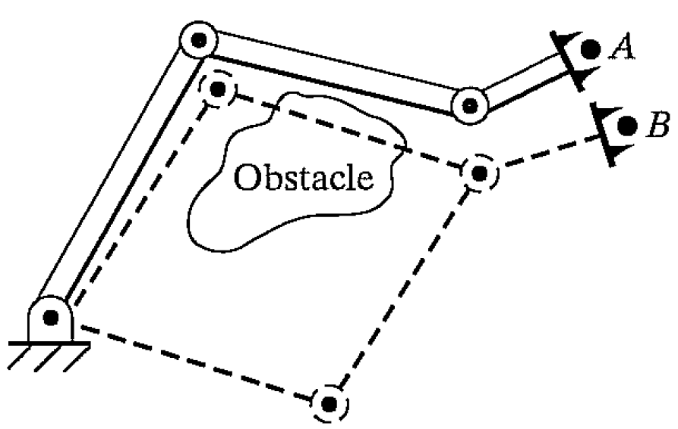
Solvability: (Multiple Solutions)
The manipulator can reach the goal with different configurations.
Ex. The planar 3DoF manipulator shown can reach any goal in the dextrous W.S. in more than one way.
➔ (Problem) the system should be able
to calculate all and choose one.
In the case of the existence of an
obstacle ➔ the configuration free of
obstacles is chosen.

Slide 13
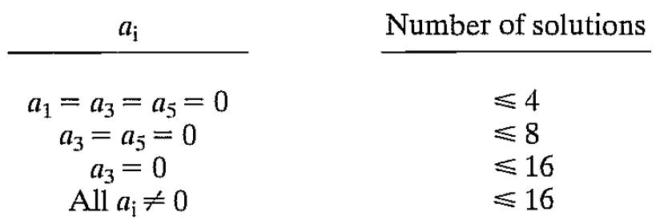
Solvability: (Multiple Solutions)
Factors that affect the number of solutions:
The number of joints (DoF).
the range of motion of the joint.
DH parameters (a_{i}, α_{i}, θ_{i}, d_{i}):
(the number of nonzero DH parameters ↑ ➔ the number of solutions ↑).
Example:
For a general 6 rotational joints robot there is a direct relation between # of nonzero a_{i} and the # of solutions

Slide 14
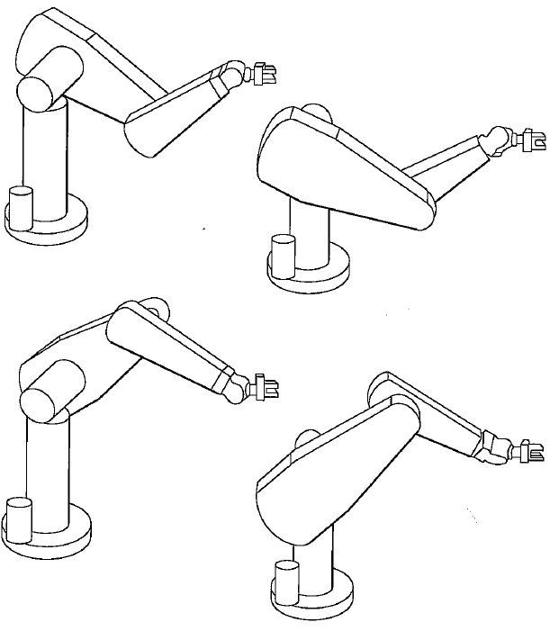
Solvability: (Multiple Solutions)
“For a completely general rotary-jointed manipulator with six degrees of freedom, there are up to sixteen solutions possible”
Example:
the Puma robot has 8
different solutions for
general goals

Slide 15
Solvability: (Method of Solution)
Recall:
Nonlinear equations
no direct method / algorithm for solving
for a given position and orientation the algorithm can find all the sets of joint variables
A manipulator is solvable
Numerical methods are dismissed as they converge to local solution

Slide 16
Solvability: (Method of Solution)
Two types of solutions:
Closed form solutions
Numerical solutions:

Slide 17
Solvability: (Method of Solution)
Two types of solutions:
Closed form solutions
Numerical solutions:
Iterative ➔ much slower
Need initial guess
Converge to local solutions

Slide 18
Solvability: (Method of Solution)
Two types of solutions:
Closed form solutions
Numerical solutions:
Iterative ➔ much slower
Need initial guess
Converge to local solutions
Out of our scope

Slide 19
Solvability: (Method of Solution)
Two types of solutions:
Closed form solutions:
Solution method based on analytic expressions or on the solution of four degrees polynomial or less (no need for iterative methods to reach a solution).
all systems with revolute and prismatic joints having a total of a six DoF in a single series chain are now solvable (numerically).
Analytical solution is for special cases only:
Several intersecting joint axes
Many α_{i} equal to zero or ±90°
Closed form solution for the robot is a very important designer objective!

Slide 20
Solvability: (Method of Solution)
Two types of solutions:
Closed form solutions:
A condition for closed form solution of a six rev. joints robot is that three consecutive joint axes intersect at a point (most of the new robots). Pieper presented an approach for solving the inverse kinematic of a robot of such condition. See the book for more information.

Slide 21
The notion of a manipulator subspace (n<6)
A manipulator that has # DoF<6 has a workspace lower than the workspace of a 6-DoF robot of the same topology, i.e. its workspace is a portion or a subspace of higher DoF robot.
A 6-DoF workspace is a subset of space.
A lower DoF robot workspace is a subset of its subspace. Which is also a subset of a 6-DoF robot subspace of the same topology.

Slide 22
The notion of a manipulator subspace (n<6)
Example:
The subspace of the two links robot is the plane (x,y), its W.S. is a subset of the plane: circle of radius L₁+L₂ (reachable)

Slide 23
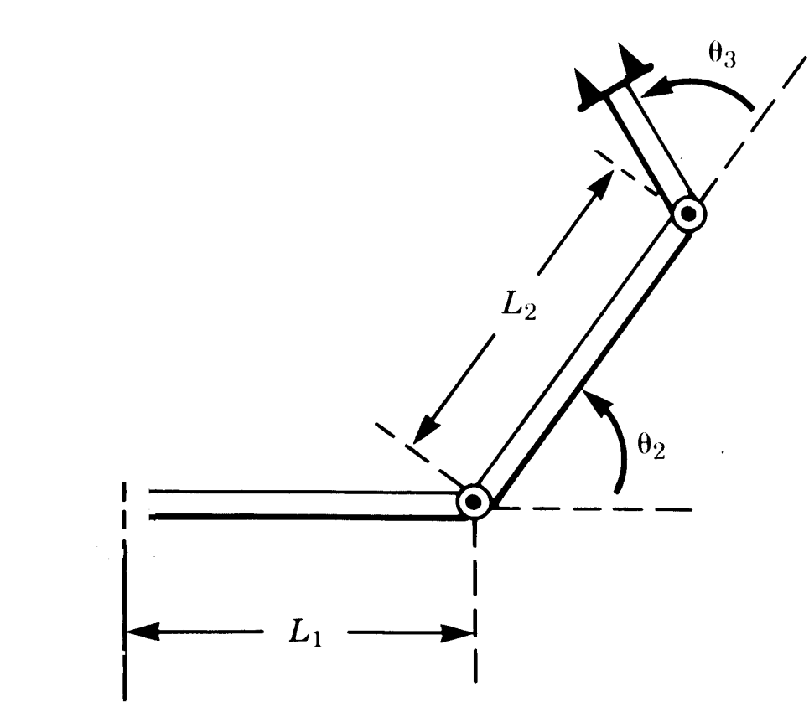
The notion of a manipulator subspace (n<6)
A way to specify the subspace of a robot is from the expression of its wrist/tool frame (position and orientation relative to the base frame) as a function of the variables of the robot.
i.e. as a function of any independent parameters.
Example:
Find the subspace of the following robot,
(x,y)

Slide 24
The notion of a manipulator subspace (n<6)
Solution:
This can be done in two ways:
Find
Then
(x,y)

Slide 25
The notion of a manipulator subspace (n<6)
Solution:
Or, use (x,y,φ) to calculate , as follows,
(x,y)

Slide 26
The notion of a manipulator subspace (n<6)
Solution:
Or, use (x,y,φ) to calculate , as follows,
Any wrist frame that does not
have the structure of lies
outside the subspace of this robot
➔ and so lies outside of its W.S.
VERY IMPORTANT
Only 3 ind. para. must appear in

Slide 27
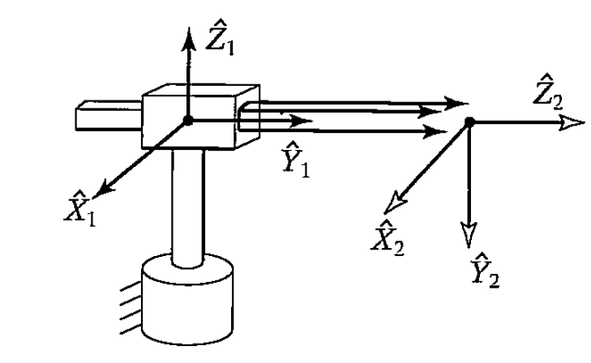
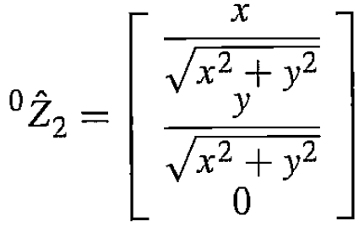
The notion of a manipulator subspace (n<6)
Example:
Give the description of the
subspace of for the
following 2 three-link robot
is a unit vector in the
direction of
(x,y)

Slide 28
The notion of a manipulator subspace (n<6)
(x,y)

Slide 29
The notion of a manipulator subspace (n<6)
2-DoF ➔ only 2 ind. parameters appear in the previous equation
(x,y)
(x,y)

Slide 30
Algebraic VS. Geometric Solutions
Algebraic solution: (example 3-DoF robot)
For this robot if (x, y, φ) are known, then one can calculate
Also from the DH parameters of this robot
(x,y)

Slide 31
Algebraic VS. Geometric Solutions
Algebraic solution: (example 3-DoF robot)
For this robot if (x, y, φ) are known, then one can calculate
Also from the DH parameters of this robot
(x,y)

Slide 32
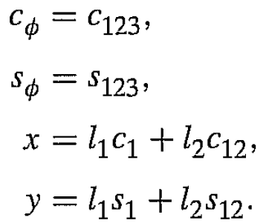
Algebraic VS. Geometric Solutions
Algebraic solution: (example 3-DoF robot)
For this robot if (x, y, φ) are known, then one can calculate
Also from the DH parameters of this robot
(x,y)

Slide 33
Algebraic VS. Geometric Solutions (Algebraic)
➔
➔
Note that:
(x,y)
Two possible solutions!

Slide 34
Algebraic VS. Geometric Solutions (Algebraic)
Also, if we calculate and , and taking into account that:
From which one can obtain that:
θ₂ was already calculated
Making use of the relation:
?

Slide 35
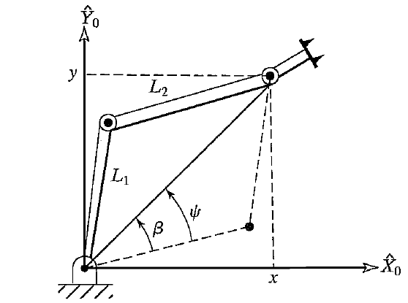
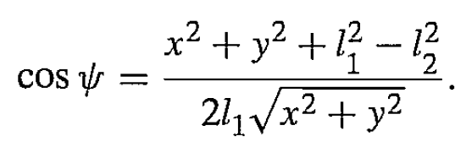
Algebraic VS. Geometric Solutions (Geometric)
For a 3D robot decompose the spatial geometry of the arm into several plane geometry.
Example: planner robot (simpler case)
Notes!

